Slide 1
Penalty Enforcement
September 22, 2020

Slide 2
Foul and penalty
a foul is an action that is an infraction of the rules.
TYPES OF FOULS.
dead ball/live ball
double/multiple
flagrant
player/nonplayer or unsportsmanlike
post-scrimmage kick
Simultaneous with the snap.
a penalty is the consequence of that action.
yardage loss
loss of a down/automatic first down.
disqualification.
perhaps a combination of the preceding.
any penalty may be declined.

Slide 3
Classification of fouls
all fouls are either dead-ball or live ball fouls.
a live ball foul is simply a foul that occurs while the ball is live.
game time line
DEAD BALL
LIVE BALL
DEAD BALL
40/25 SEC
DURATION OF DOWN

Slide 4
Types of plays
every live ball foul occurs during either a loose-ball play or a running play.
a loose-play is action during:
a backward pass (including the snap) illegal kick or fumble made by team a in or behind the neutral zone prior to a change of team possession.
A legal forward pass.
A free kick or scrimmage kick
the run or runs which precede any of the above.
a running play comprises all live ball action which is not included in a loose-ball play.

Slide 5
Types of plays
loose ball play-pass
Catch
Line of scrimmage
Snap
Basic spot
Run
A run followed by a legal forward pass, both are part of one loose ball play.

Slide 6
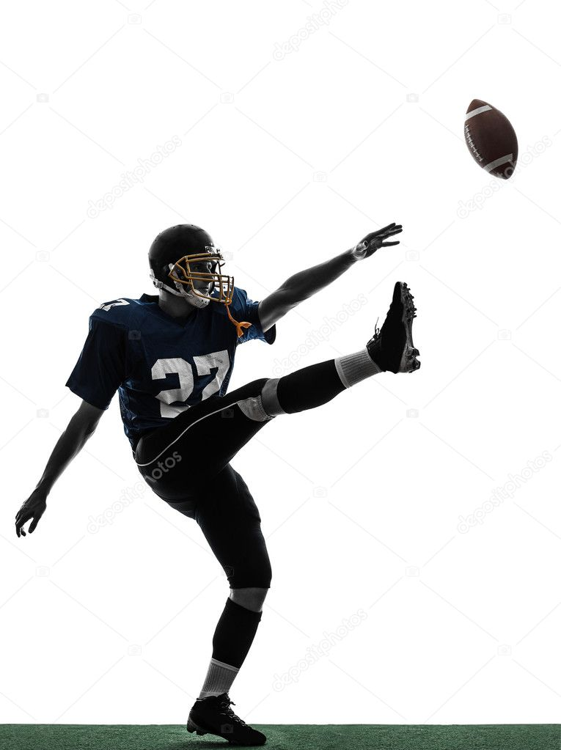
Types of plays
loose ball play-punt
Catch
Line of scrimmage
Snap
Basic spot
Backward Pass
A backward pass followed by a scrimmage kick both are part of one loose ball play.

Slide 7
Types of plays
loose ball play-fumble
Line of scrimmage
Snap
Basic spot
Recovery
Scramble
Fumble
Run
A run followed by a fumble behind the natural zone both are part of one loose ball play..

Slide 8
Types of plays
running play
Tackle
RUN
End of the run = Basic Spot

Slide 9
Types of plays
running play
Fumble
Out of Bounds
RUN
SCRAMBLE
Basic Spot
There is only one run on this play. The scramble is part of the running paly. Thus, the basic spot for any penalty that occurs during the scramble is the spot of the fumble.

Slide 10
Types of plays
running play
Fumble
Fumble
Recovery
Recovery
Tackle
FIRST RUN
SCRAMBLE
SECOND RUN
FIRST RUN
SCRAMBLE
Basic Spot
Basic Spot
1st Running Play
2nd Running Play
Two runs, two running plays, two basic spots. For fouls during the first run and ensuing scramble, the spot of the fumble is the basic spot. For fouls during the second running play, the basic spot is where the ball becomes dead.

Slide 11
Types of plays
loose ball play-pass
Tackle
Basic spot
Running Ball Play
Run
Catch
Line of scrimmage
Snap
Basic spot
Loose Ball Play
Run
The forward pass and the run preceding it are a loose ball play. Once the ball is caught, a separate running play begins..

Slide 12
Basic Spot
the basic spot is determined by the type of play that occurs during the down. it is either the:
end of the run.
previous spot
post-scrimmage kick spot.
The spot of the foul is never a basic spot.
All-but-One.
Three penalties enforced from the basic spot.
One from the spot of the foul.

Slide 13
All-but-one principle
Basic Spot
Defensive Foul
Behind Basic Spot
Defensive Foul
Beyond Basic Spot
Offensive Foul Behind
Basic Spot Enforced from
The Spot of the Foul
Offensive Foul
Beyond Basic Spot
Team Direction

Slide 14
Post-scrimmage kick (psk) fouls
Post-scrimmage kick rules apply only if all of the following conditions are met:
The foul is by team r.
The foul occurs beyond the expanded neutral zone.
The foul takes place between the snap and the end of the kick.
The ball crosses the expanded neutral zone.
Team R will next put the ball in play.
POST-SCRIMMAGE KICK ENFORCEMENT
PSK WINDOW
Kick beyond NZ
Subsequent Run
KICK
Ball crosses the neutral zone
R Possesses the ball & ends the kick
End of Play
SNAP

